Slide 1
System Design Document
For RMCH Unit

Slide 2
Overview
Remote Management Of Car Head Unit is a UI based client-server system. The registed user of this system can use this application to manage several things including rule based monitoring and health check. The user can monitor GPS location, milage / liter, engine heat signatures, OIL level, Batery life, Kilometer driven and also service due etc.

Slide 3
Requirements and Goals of the System
As per this new requirement we have to provide a new feature to the client, called
Parental control. Below are the list of functional and Non-Functional requirements
Functional Requirements:
Users should be able to set parental control using a self-service portal.
Users should be able to get alert message when car / vehicle starts.
Users should be able to disable the alert / notification service at any time.
Non-Functional Requirements:
The system should be highly reliable, once user data is set it should not be lost.
The system should be highly available. The system should be up and running at any point in time so that the user does not miss the notification.
Users should get Realtime data without any lag.
Not in scope:
Vehicle tracking
User would have to user the app only to start / stop the notification service. (Stop message through phone / CSR call / etc are not supported with this release)

Slide 4
Assumptions
There is already a working client-server application which supports other monitoring features for car head unit.
The self-service portal is already available for the user.
The car owners are using other features to access car health, censor information and GPS information etc.
The application is already deployed in cloud.

Slide 5
System APIs
We can have SOAP or REST APIs to expose the functionality of our service. The following could be the definitions of the APIs for setting vehicle security configuration:
~~/securityconfig/
[POST message] with request body containing details.
setSecurityConfig(api_token, user_id, name, description, locations[], notification_type, message_language, notification_details, message_contents)
Parameters: api_token (alphanumeric): This is a token given / set in user's device when user registers with the app and logs in first time. User_id (string): This is the user id of the client / user name(string): Name of security configuration. description (string): Optional description of security configuration. locations (string[]): list of locations which is allowed by user. notification_type (string): Type of notification , e.g., Mail, WhatsApp, Text Message, etc. message_language (string): For example English, Hindi, (Any local language), etc. notification_details (string): How many reciepients, retry till stop message or time limit, frequency, escalation, etc. message_contents (string): Preffered message needs to be sent.
Returns: (string) A successful registration will return HTTP 201 (request successful) and a message to the user with all the notification details.

Slide 6
High Level Design
At a high-level we would need the following components:
Processing Queue: Each gps / sensor data will be pushed to a processing queue to be de-queued and immediately processed by stream processing system. [ Message Format from the Vehicle :- { Car-ID , Longitude , Latitude } ]
Metadata DB: The database would save user specific rules and other details for notification service to work.
Cache: The cache would have latest user specific rules loaded from DB to support the stream processor
Stream processor: We need high speed stream processing system for reading and processing data in milliseconds time interval.
Batch Processor: We also need batch processing system to analyze the stream of events for reporting etc.
Load Balancer: We need Load Balancers as we would have a scaled up version of our services for high availability.
Secure Network: We would need a secure network such as VPC. If we are planning to deploy over multiple Regions with two different VPCs we can have inter VPC communication with VPC peering (No Overlay network). We can have many AZs (In the same region) under one VPC with highspeed communication lines.

Slide 7
Database Schema
Notification rules metadata storage - MySQL / MongoDB
Notification Rule Table | Notification Tracker | User
User Id Rule Id Car / Vehicle Id Name Description Recipients Message Language Message Text frequency Escalation matrix Notification Stop criteria Location | Rule Id Notification Id Notification sent time Notification acknowledgement time Notification acknowledge by recipient Number of retries | User Id Name Email Address Age registration details, etc.

Slide 8
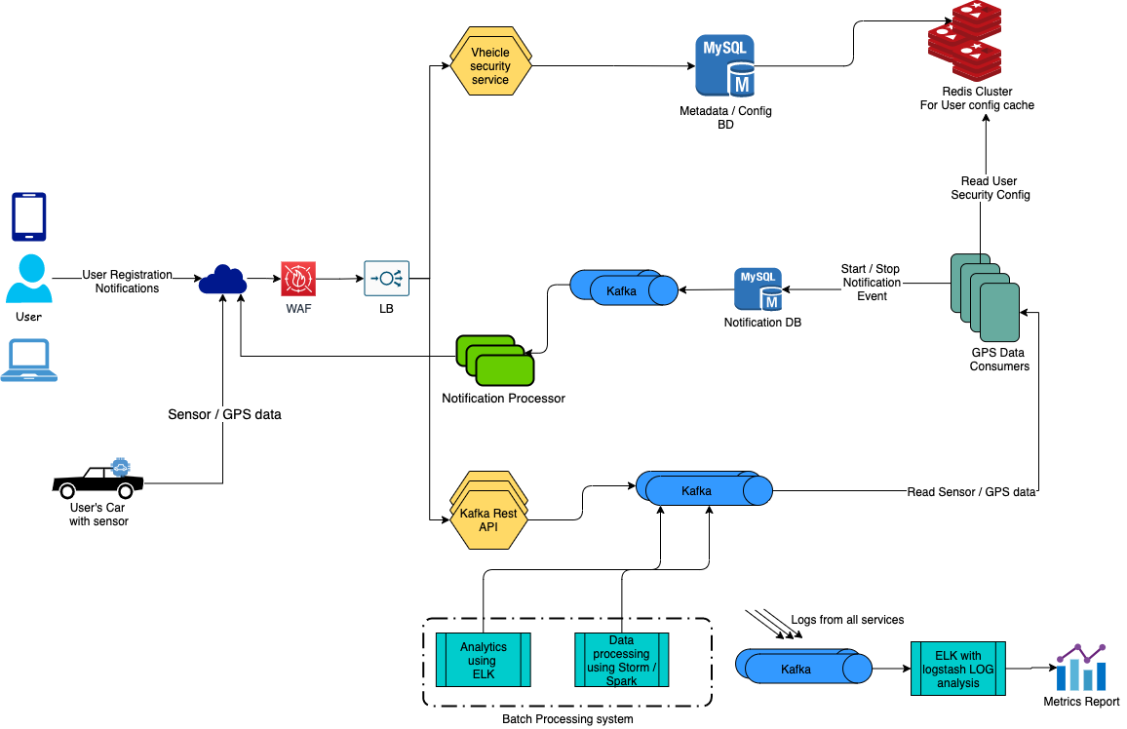
System Architecture Overview

Slide 9
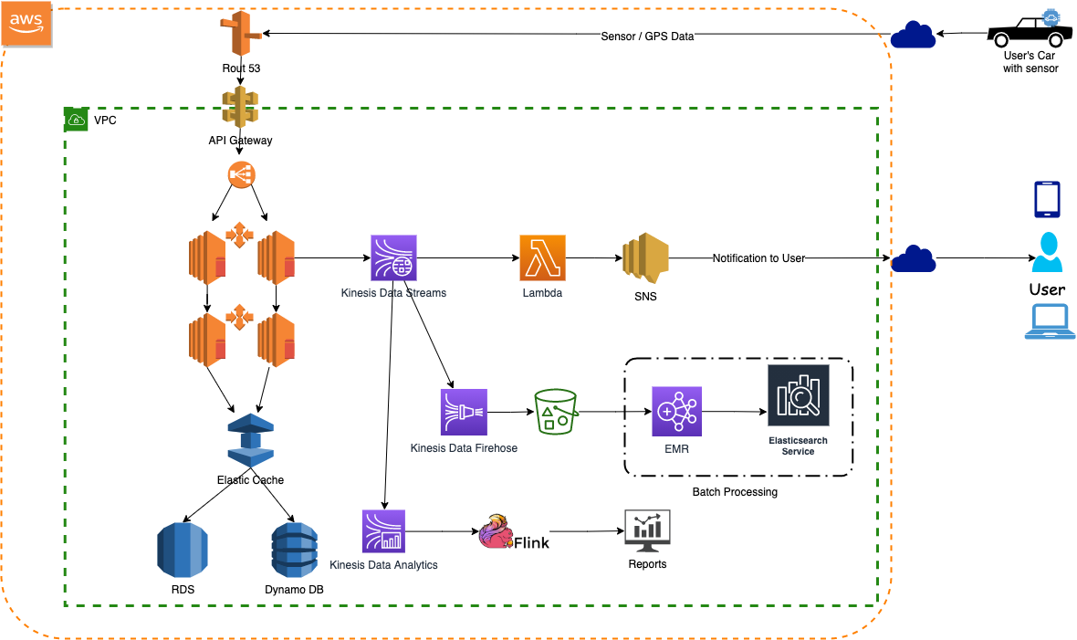
System Architecture Overview - AWS

Slide 10
Client side flow
Setting Rule
User logs in to the application.
A new option in the form of button / link will be shown to the user to click and set parental control rules.
Clicking on the option the application will open a new page / tab / accordion to set all the parental control rules.
The user can give any name for the rule and then set the conditions for notifications.
Once the rule is created the user can apply the same on any pre-registered vehicles.
The user will also have an option to switch on / off the rule for any particular vehicle.
The application will mandate the user to set at-least 2 recipients considering the severity of the rule.
If the User is selecting the rule as normal severity then application may ask for at-least 2 recipients.
If the Rule is set to high on severity then the application may ask for at-least 3 recipients and more than one mode of notification, Ex:- Txt msg, Mail, WhatsApp, Call, etc.

Slide 11
Client side flow
How the Application work
If the car is started the user would get a pop-up in the form of push notification in the app / text message.
If the car is driven out side of the specified location then the user will get a pop-up / text notification with a message tone / vibration of the phone so that this can draw users attention to take action.
After every specified duration the user will keep getting pop-up messages.
If the user is not responding then the pop-up message / txt message will be sent to other recipients mentioned in the escalation list. It might happen that the other recipients have not installed this app, so the message will be sent as text message / pop-up message.
The Notification can only be stopped by the user, this is in consideration with the security. User is the best judge of the situation and the decision should only be taken by the one who has set the Rule whether it is OK to stop the notification or not.
The user should use the app / resisted mail id to send a stop notification code which will be generated by the application as an OTP. The one time password would be sent to the user at that point of time to either registered mail-id / registered phone / both.
Exception
The user will get a message every time the car is started, so if the car is started 5 times in 1 mins then the user will get 5 messages. If the car is being for 'N' number of times over the journey then for every start the user will get message ?
If the car is driven out of the specified location / area and then immediately brought back to the location boundary then also the notification service will keep sending the notification messages till it is stopped by user / owner.
If the User doesn't have access to Phone / Mail then user can call-up CSR / help line to stop the notification by answering a few PII questions.

Slide 12
Server side flow
Security Config Service
This service will be responsible to store the client specified rules to Metadata DB and the same will be replicated to Cache.
The same service will be responsible for created / updated / deleted / read of config rule.
The user can start and stop the Notification using this service
Notification Processing Engine
This component is responsible get the stream of GPS data from broker.
Depending on the Car-Id present on the GPS data it will look for the client rule and if the rule is active then it will generate an start notification event.
If the rule is active then it will create a notification record in Notification DB with an auto generated Rule ID.
The service also create a cache entry for this Rule-Id, Car-Id, Notification-Id, etc.
The start notification event gets published to a broker through DB to be processed by another service.
In case the user chooses to stop the service and the same gets reflected in cache then this service will immediately get the cache entry for Notification service by Rule-Id and Car-Id and update the Notification DB record with stop timestamp, recipient name, etc.
The cache entry will be removed.
Eventually a stop notification event will get generated to be process further.
For any GPS data if there is no record in the Cache and the Rule is Active the service will create a Car-Stated Notification Event and a cache entry will be created with a TTL little more that the GPS Data time delay.
If the car started cache entry is present then this service will not create a Car-Started event.
If the car is not sending the Sensor / GPS data then passed TTL the cache will automatically be deleted after the Epoc time is lapsed for GPS data.

Slide 13
Network Security
Security would be implemented in various places over the network flow
Load balancer would be configured to listen to port 443 (Cert file will be deployed here)
EC2 instances would be created under various security group to only white list the traffic from load balancer.
EC2 instances will not have any public IPs the only point of interaction to out-side world would be the LB.
In-order to login to EC2 instances we would have Boston Host (Jump server) created opening port 22.
The same Boston Host will be used to login to DB server as well.
Cert file will be created from IAM / ACM tool.

Slide 14
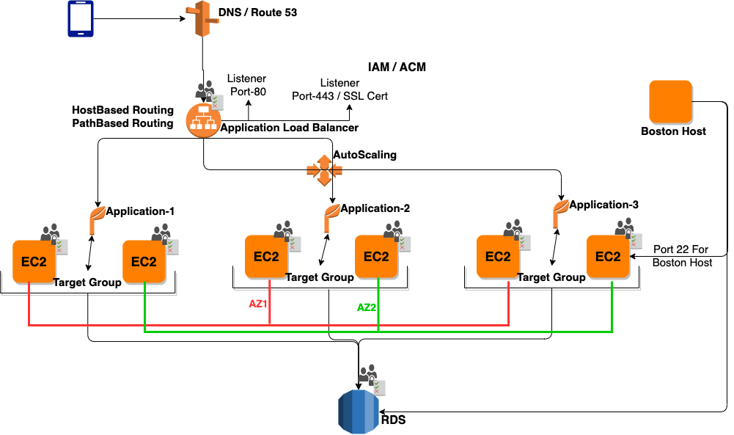
Security Implementation over network

Slide 15
Operational Details
How to achieve Non Functional requirements
High response time
Using Kinesis gives us ability to process thousands of records per Shard.
Lamda is auto scaled and can support processing speed of Kinesis same goes for SNS service.
Redis cluster provides high throughput cache cluster.
High Availability
As the system overview depicts we have Elastic load balancer in place. We are going to spawn multiple datacenters in different availability zones with cross region replication.
Replication of both Kinesis data streams and Redis cache.
Dynamo DB / RDS are highly available and scalable databases.
Security
VPC secures all the internal communication.
User App uses the API Token which is provided and set on user's device at the time of user registration and logging in to application.
** There are many Vehicular cloud computing solutions which provide secure communication between vehicle and server**

